Slide 1
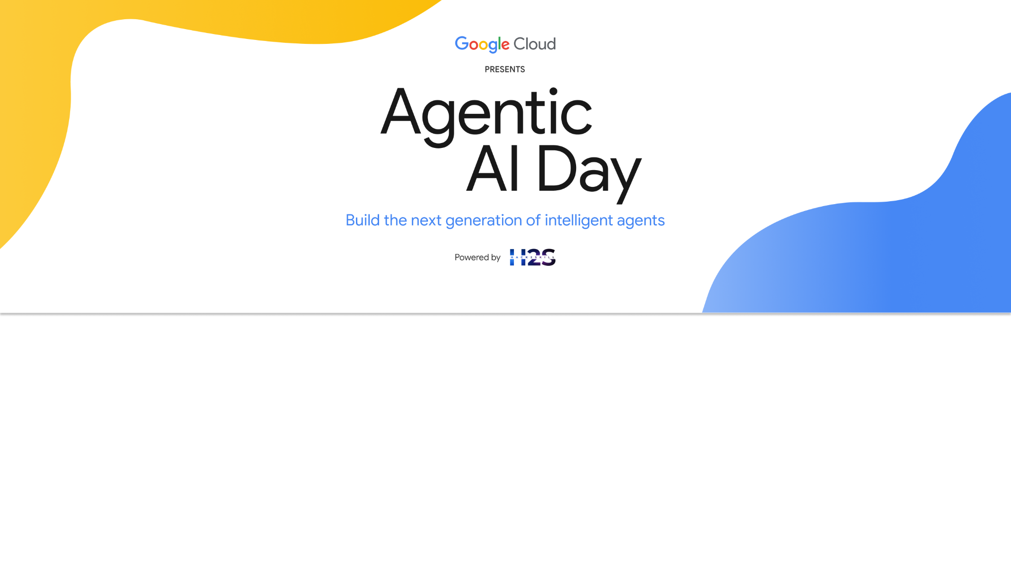
Team Details
Team name: ஆசிரியர் (Aasiriyar AI Team)
Team leader name: Soundararajan Arunachalam
Problem statement: Empowering Teachers in Multi-Grade Classrooms

Slide 2
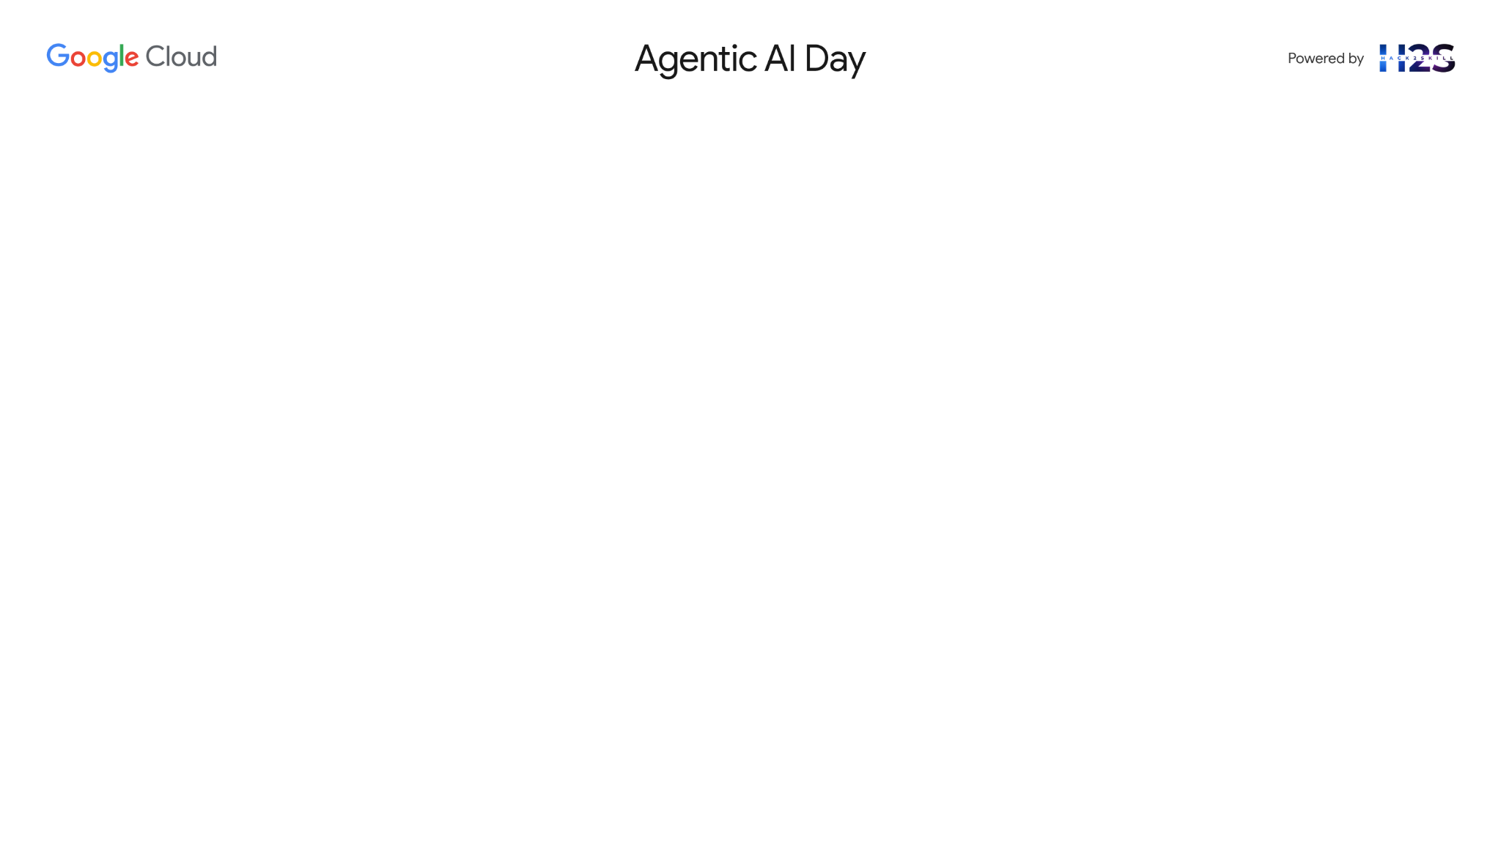
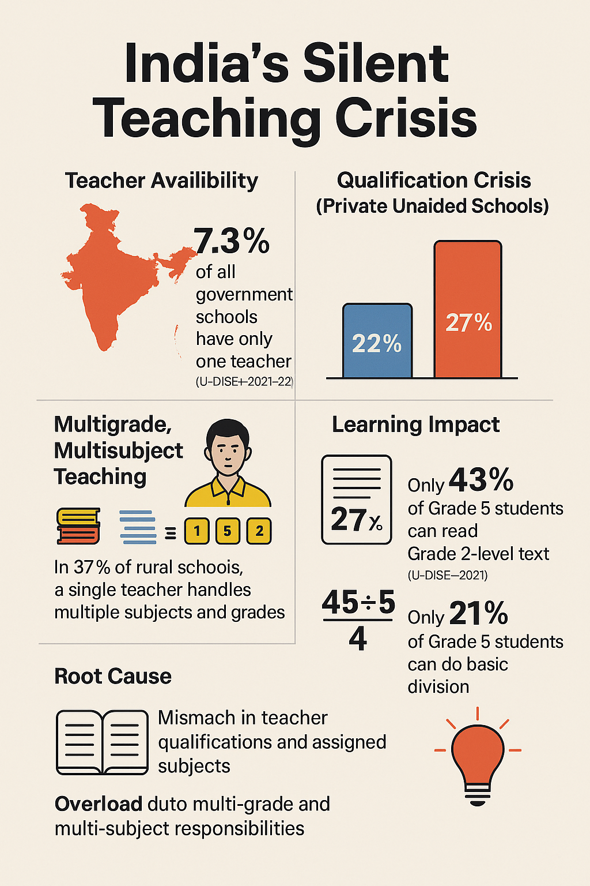
Problem statement: Empowering Teachers in Multi-Grade Classrooms
"The future depends on what you do today." – Mahatma Gandhi
One empowered teacher can shape the future of 30 students, creating a ripple effect that transforms entire communities.
Shaping the future begins with empowering teachers—providing them with modern tools, engaging content, and continuous training. Inspired teachers cultivate critical thinking, deep understanding, and skills essential for students to thrive in a fast-changing world.

Slide 3
Brief about the Solution
Sahayak: AI Teaching Assistant
What Sahayak Does
Simplifies Prep Work – Auto-generates lesson plans, quizzes, worksheets
Supports Local Languages – Handles regional input via Gemini frontier models
Creates Interactive Content – Visuals, games, and learning materials
Adds Audio Power – Audio materials and speech-driven responses

Slide 4
Google technologies used and their use cases
Google ADK
Gemini Model
Google Cloud Platform (GCP):
Vertex AI – RAG Engine
Cloud Run – Run Agents
Google storage : Stores PDF , audio recaps and assignment files.
Fire Base studio – IDE used for development
Google Container Registry (GCR) : Stores Docker images for the agents.

Slide 5
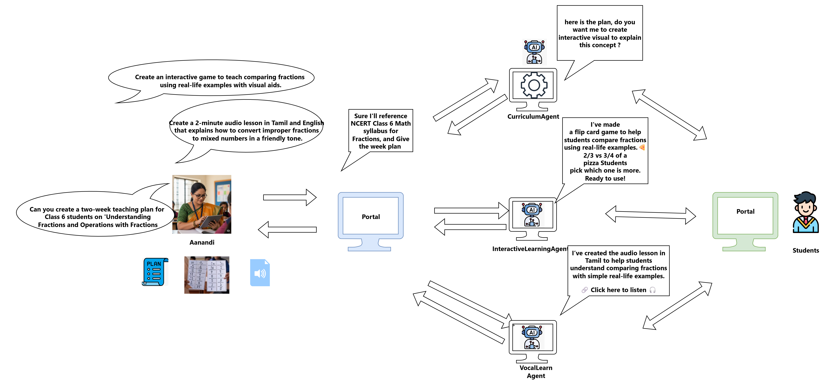
Process flow diagram or use-case diagram

Slide 6
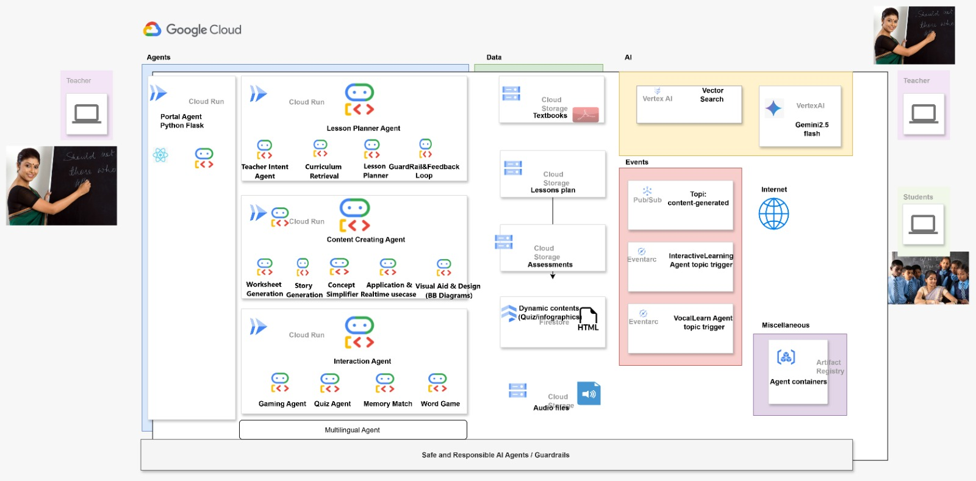
Architecture diagram of the proposed solution(Planned)

Slide 7
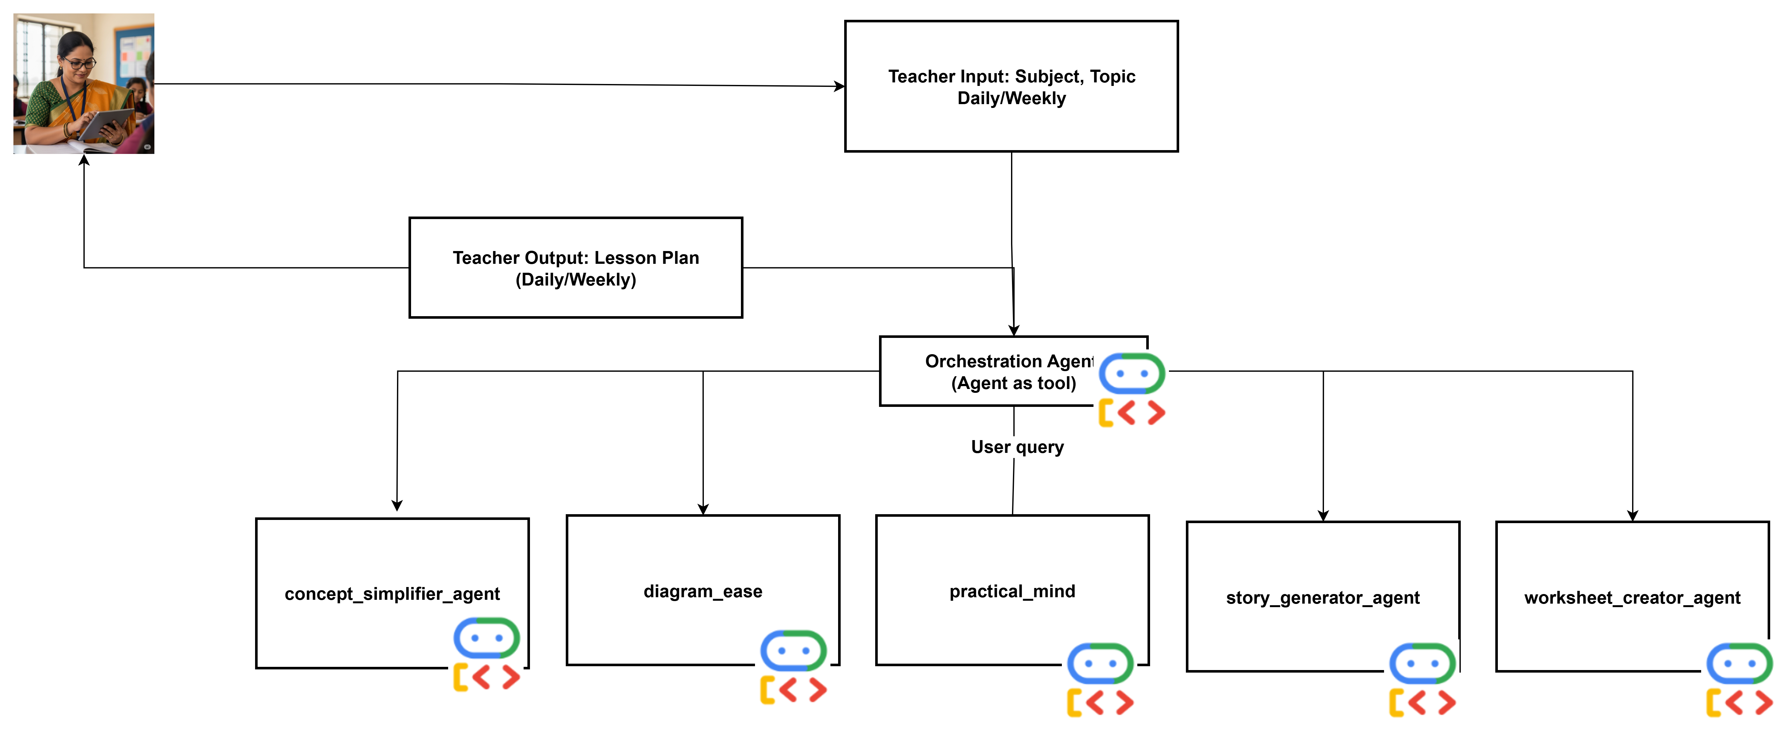
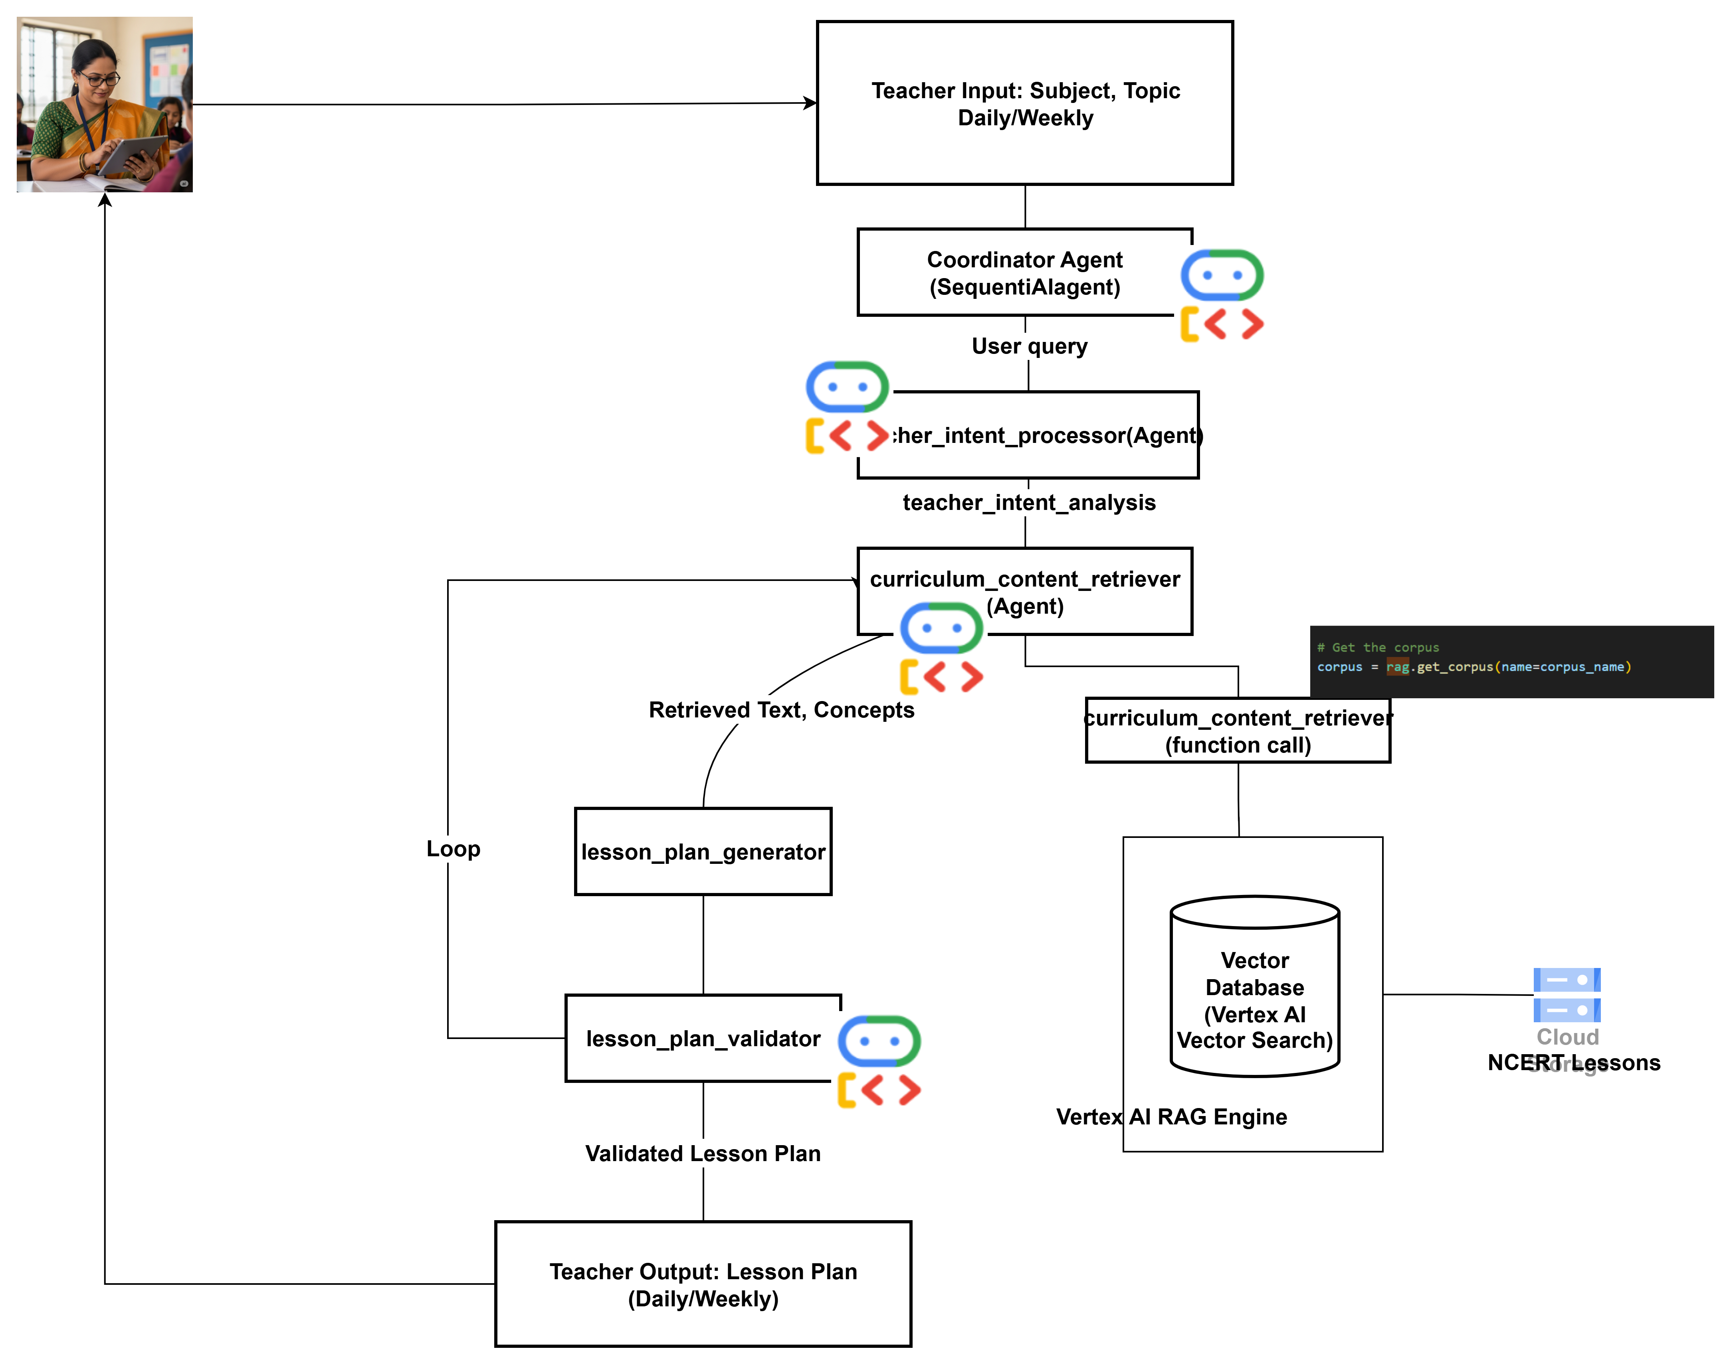
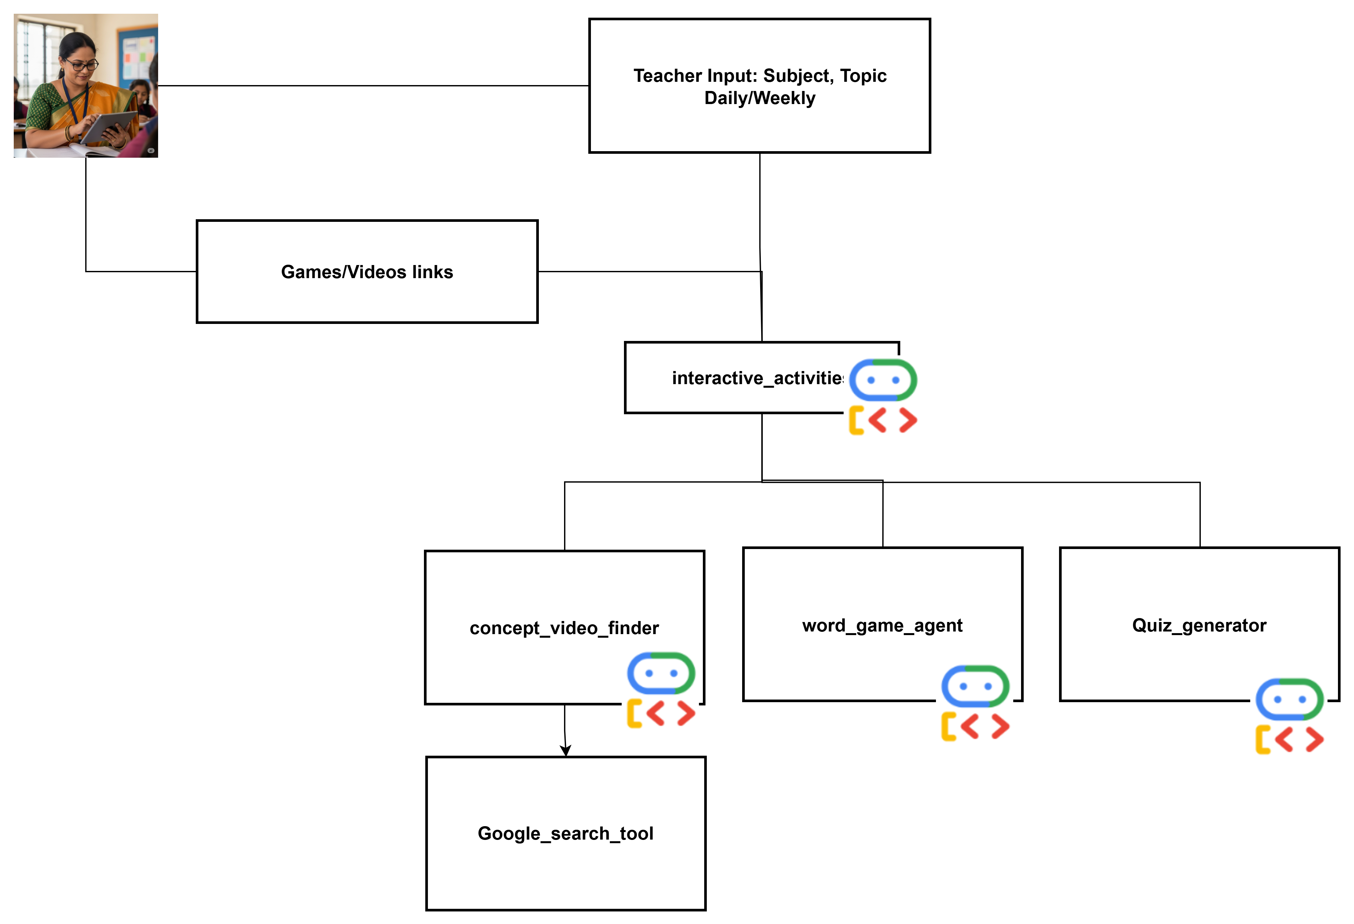
Details design
SequencialAgent with RAG
Agent As a Tool

Slide 8
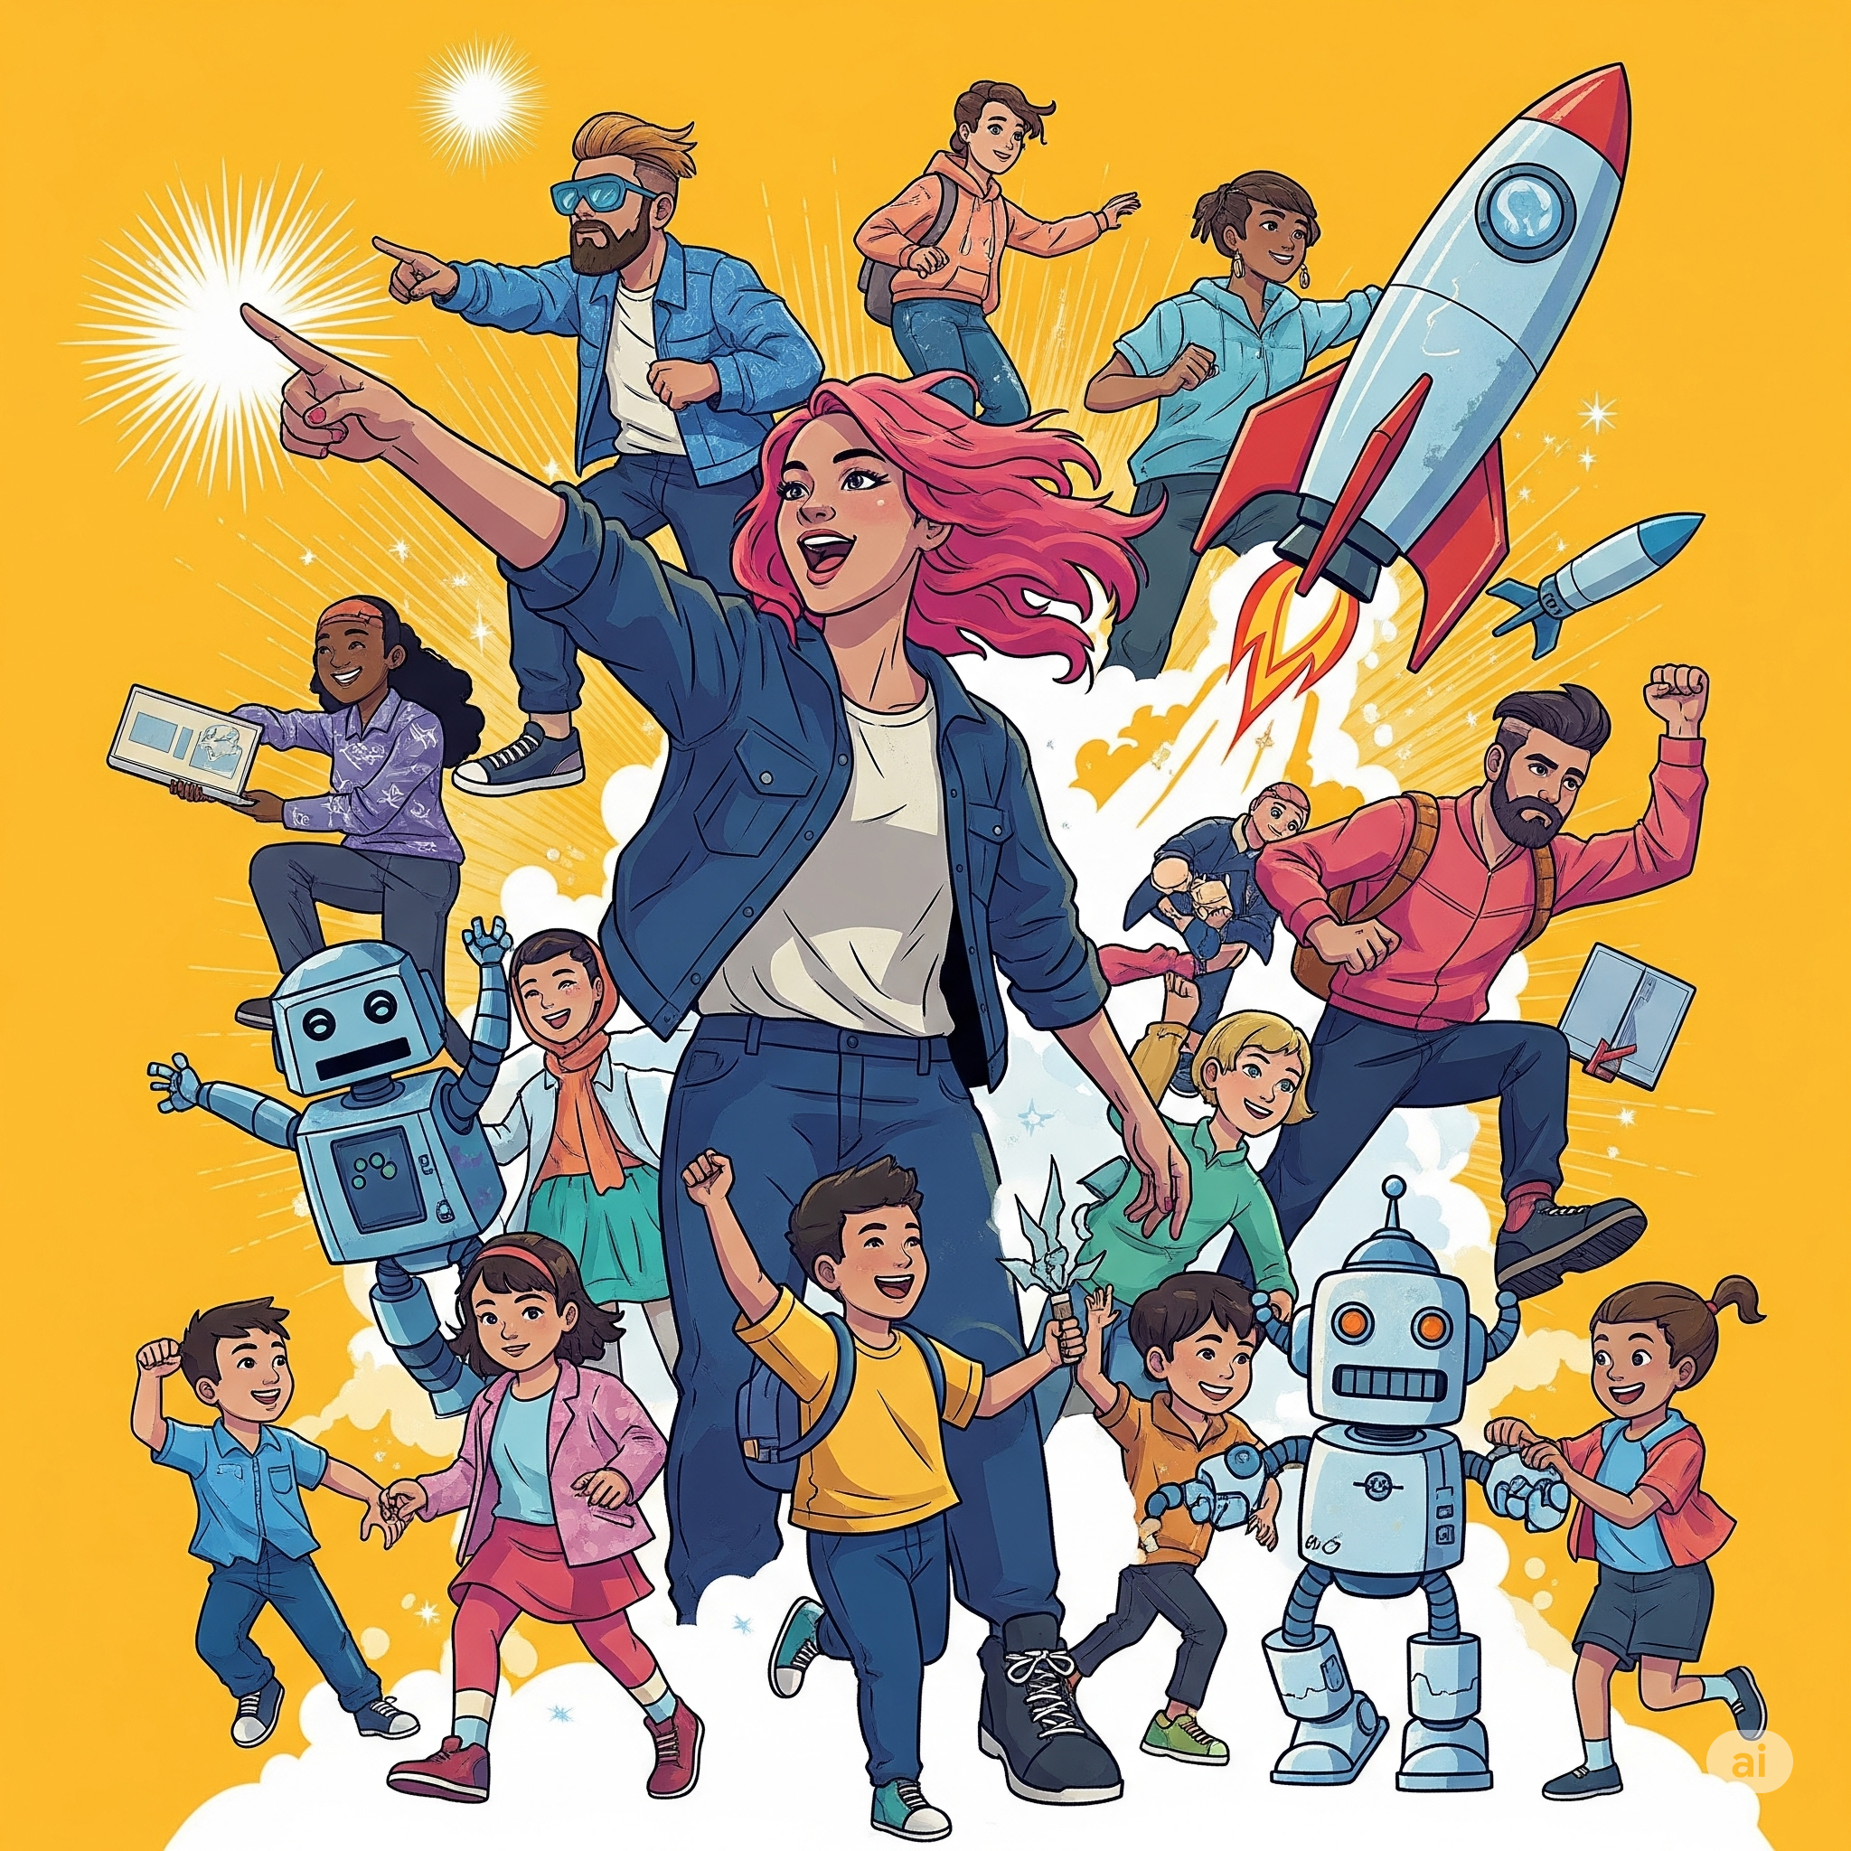
Demo & Code walkthrough
https://github.com/soundardpm/teacher-sahayak

Slide 9
How is this solution different from others
How different is it from existing solutions?
Hyper-localization: Unlike generic EdTech platforms, Sahayak generates content in regional languages with culturally relevant examples and contexts specific to rural and semi-urban India.
Most edtech platforms focus on student-facing tools or generic content delivery, this is teacher-based tool.
Low-tech compatibility: Works with minimal technology (can export to printable formats, create blackboard-friendly visuals) unlike solutions requiring 1:1 devices.
Multimodal input/output: Accepts voice, text, or images as input and generates diverse output formats suitable for varied teaching contexts.
How it solves the problem
Reduces preparation time: Automates the creation of lesson plans, worksheets, and visual aids that would normally take hours.
Enables differentiation: Instantly creates variations of the same material at different complexity levels for different grades.
Bridges resource gaps: Provides access to high-quality teaching materials even in schools with limited resources.
Supports local language: Functions in local languages, enabling teachers to provide instruction in students' mother tongues.

Slide 10
Future Scope
-We aim to implement analytics-driven evaluation to assess students’ subject-wise proficiency. This data will help us optimize study materials and provide focused support in areas where students need additional guidance for better learning outcomes.
- Student absenteeism due to prevalent cultural and family functions in India creates significant learning gaps, further burdening already strained teachers. Our strategic vision extends to empowering parents with intelligent, localized support mechanisms. This will facilitate continuous learning during absences, reinforcing classroom concepts.
- "Today, many students are unable to explore all elective subjects due to limited resources and support. In the future, we aim to create opportunities for interested students to learn multiple skills, empowering them with a diverse and holistic education."
-"We are planning to build a platform where teachers can create, share, and collaborate on high-quality educational content. This initiative will inspire them to produce engaging materials such as explainer videos, interactive lessons, and game-based learning content.“

Slide 11


Slide 12
Features of this Solution
📚
Course material
Generation
Lesson Planner
Assessment Builder
Worksheet Creator
🌐
Content Creator
Worksheet creator
Story generator
Blackboard-Friendly Diagrams
Concept Simplifier
Use-case / Application generator
Concept Visualization5
🧑‍🏫
Interactive Activity Creator
Concept Video Finder
Game Builder

Slide 13
Impact of the solution
Designed for the multi-grade classroom reality of rural India rather than imposing Western single-grade classroom models.
Works within existing constraints (limited connectivity, minimal technology, vernacular medium) rather than requiring significant infrastructure upgrades.
Culturally contextual content generation that reflects local communities, traditions, and references.
Adaptable to varying levels of teacher tech proficiency with simple, intuitive interfaces.

